Slide 1
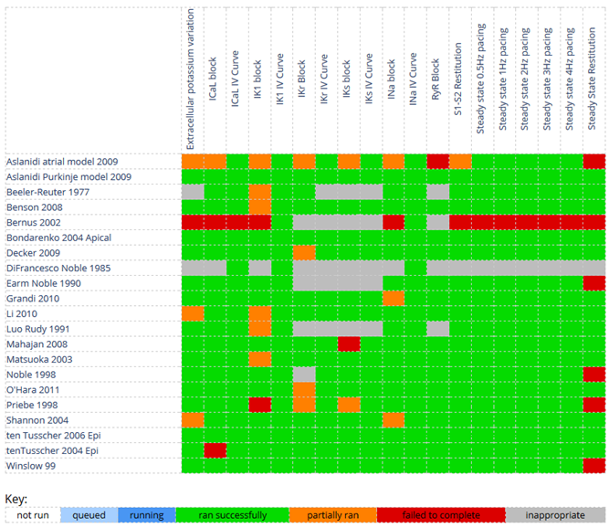
Characterising and comparing models
https://chaste.cs.ox.ac.uk/FunctionalCuration
Notes:
Jonathan Cooper works on tools for examining how models of heart cells behave in different situations. He uses a domain-specific language for describing the different models, and has developed another language for describing experiments performed on these models, much like wet-lab researchers perform experiments on real cells. A website brings these together and allows you to investigate how the models behave. Green indicates experiments that ran successfully; red ones that failed. You can click through to view and compare detailed results.

Slide 2
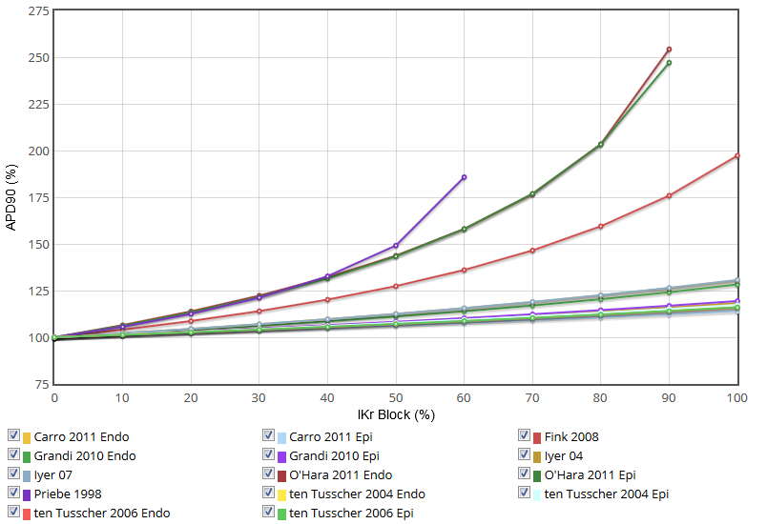
Different reactions to drug action
Notes:
For instance, we can see how different models of human heart cells react in an experiment that mimics how many drugs can have adverse side effects on the heart, potentially leading to heart attacks. We see that different models respond by different amounts as the level of drug action increases.

Slide 3
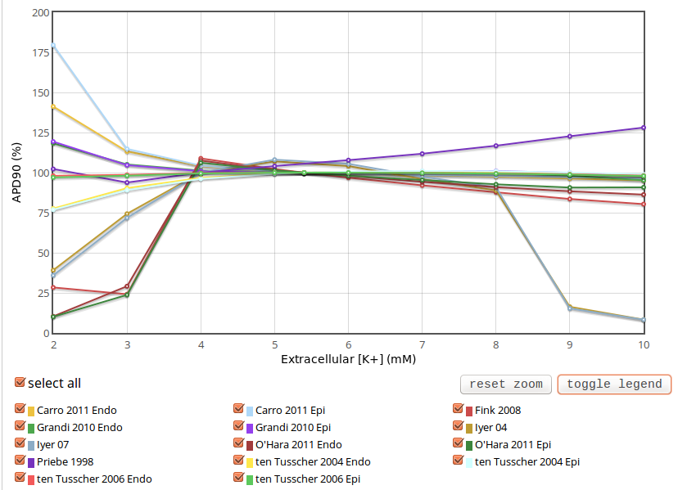
Different effects of cell environment
Notes:
We can also see how changes in the chemical environment of the heart affect different models in different ways. Here we even see opposite effects depending on the model.
The models can then be examined in detail to see why these different behaviours arise, and hence understand more about how the heart works.

